Slide 1
Neurodivergence in the US Criminal Justice System
REU Mid-Summer Presentation
Caoilainn Christensen
Mentored by Dr. Anne Perrotti
@caoilainnsc

Slide 2
How do the experiences of neurodivergent individuals differ from those of neurotypical individuals in the American criminal justice system ?
@caoilainnsc

Slide 3
Key Terms/Abbreviations
ASD
Autism Spectrum Disorder
Neurodivergence
ADHD
Attention Deficit-Hyperactivity Disorder
ASD
Dyslexia
ND/NT
Neurodivergent/Neurotypical
ADHD
CJS
Criminal Justice System
@caoilainnsc

Slide 4
Gap in Literature
Current work mostly focuses on each disability under ND individually, not ND as a whole
The work done in the United States is lacking compared to research in the Europe (especially the UK)
No existing overall analysis of the experience of ND individuals in the American CJS
@caoilainnsc

Slide 5
Background/Initial Findings from Current Literature
ASD and Sexual Offending/Criminal Activity
ADHD and Substance Abuse/Criminal Activity
ND and Education in the CJS
Individuals with ASD are no more likely to offend than individuals without ASD (including sexual offending), but there seems to be a relationship between the disorder and sexual abusive behaviors for individuals who do offend
Individuals with ADHD have a greater risk of offending, and specifically there is a link between ADHD and substance abuse. This is a topic that is heavily studied (the links between the disorder and offending/substance abuse) in the current literature
Neurodivergent individuals (and individuals with learning disabilities) may have a harder time within the education system, and this is a greater issue within the American criminal justice system. Current literature examines the issues and potential solutions to this problem.
@caoilainnsc

Slide 6
Methodology
01
02
03
04
Gathering literature
Converting pdf to txt
Using Google Scholar and current sources' reference lists to find relevant papers
Copying the text in each pdf and reformatting in a new txt document
NLP using spaCy
Data analysis
Writing code to process the documents and identify themes in the text
Using the collected data to find the overall differences in experiences
@caoilainnsc

Slide 7
Gathering Literature
Neurodivergence
Neurodivergence criminal justice system
Google Scholar Search
ASD
Autism criminal justice system
Hand Search
ADHD
Went through each articles references for any additional relevant articles
Any article that was about the disorder in the context of the CJS, and was published in the United States
ADHD criminal justice system
Dyslexia
Dyslexia criminal justice system
@caoilainnsc

Slide 8
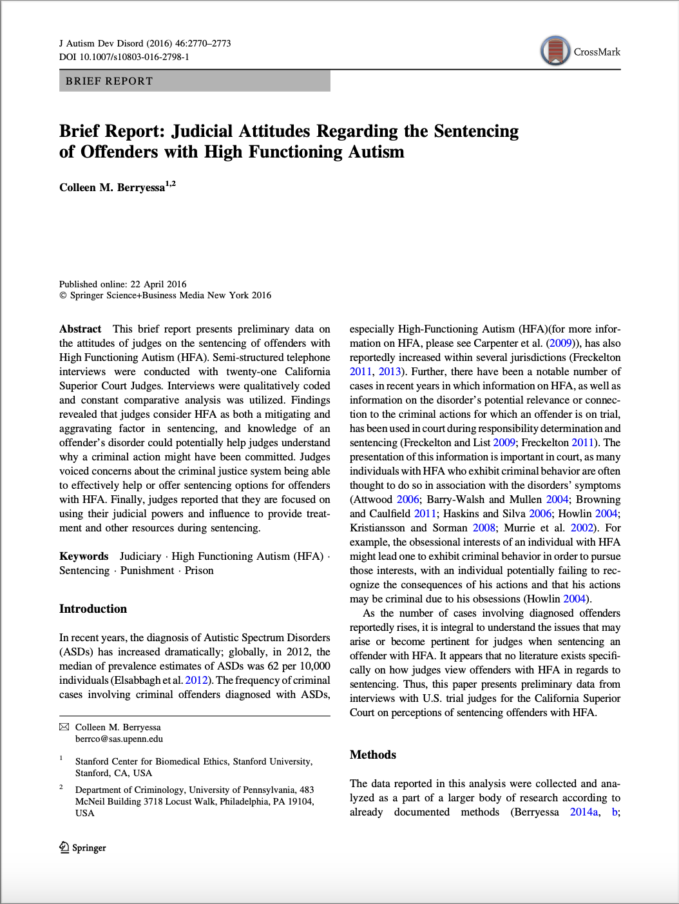
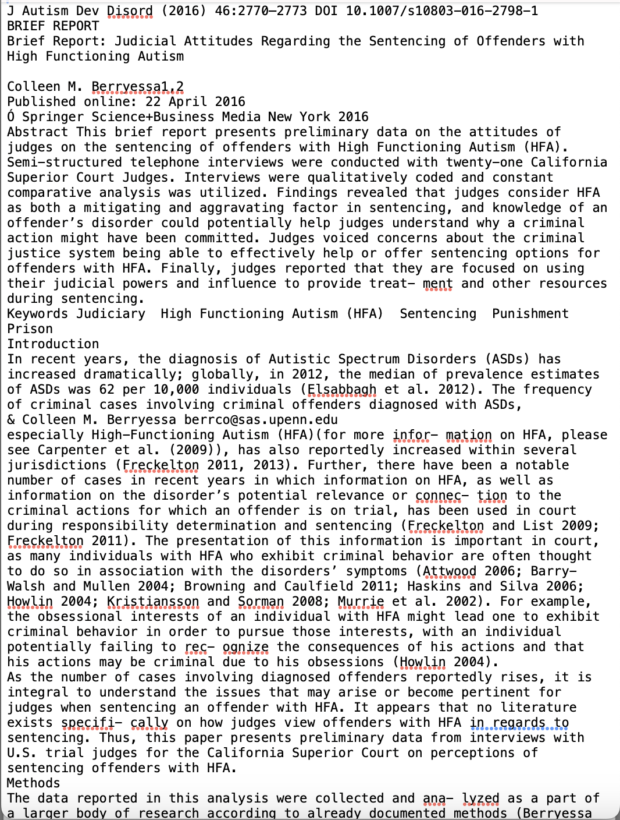
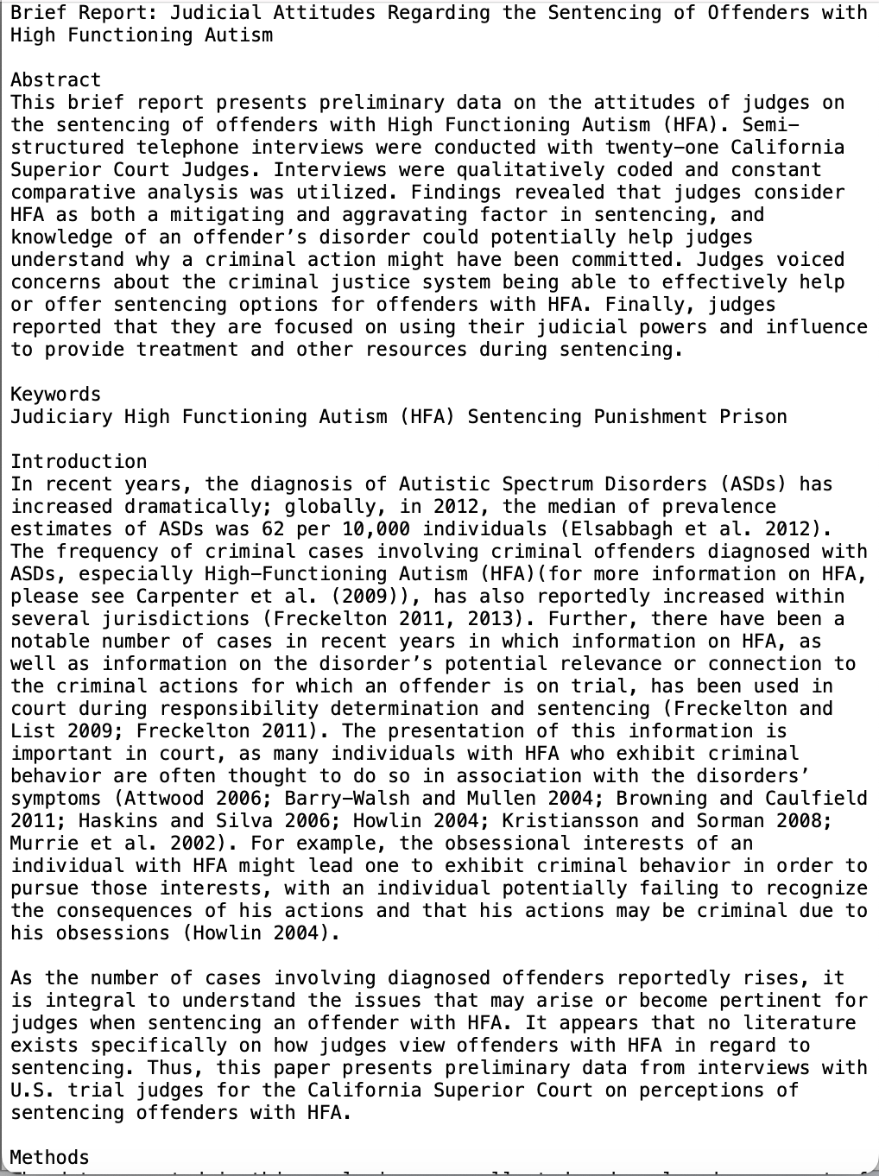
Pdf to txt
@caoilainnsc

Slide 9

NLP using spaCy
In progress: writing the code to pull out the main themes of the literature to discover the discussions surrounding ND in the American CJS - the findings will be analyzed to provide a general understanding of these differences
@caoilainnsc
Screenshot taken from spaCy’s homepage https://spacy.io/

Slide 10
Preliminary Results/Observations
ND (and its Treatments) Effect on Recidivism
Knowledge/
Perceptions of ND Individuals in CJS
ASD and CJS Interactions
Childhood ADHD and Criminal Activity
ND and Pleas/Sentencing
ND and Criminal Responsibility
@caoilainnsc

Slide 11
Quantitative Information on Data
Pieces of Writing:
101 total (49 ASD, 39 ADHD, 5 Dyslexia, and 8 ND)
Prominent Authors:
Robert Eme (9), Colleen Berryessa (6), and Lindsay Shea (5)
Common Topics:
Identifying Problems/Proposing Solutions (35), exploring relationship between criminal activity and the disorder/ND (37)

Slide 12
Summary, Conclusion, and Future Plan
Lack of US Research on ND in CJS
Initial Findings Show Some Potential Themes
This project aims to bridge the gap in research by gathering existing literature for analysis
Examples include ADHD & substance abuse, ASD and & sexual offending, and issues with ND & education in the CJS
Continuing pdf conversion and NLP
Analysis and Final Discussion
The next step is to finish converting the papers to txt files, finish the code to analyze the text, and then run the code with the papers
Finish the work by analyzing the results and completing a final discussion
@caoilainnsc

Slide 13
References
CREDITS: This presentation template was created by Slidesgo, including icons by Flaticon, and infographics & images by Freepik
Admire, D. S. (2007). Learning Disabilities and Attention Deficit Disorder: A New Approach for the Criminal Justice System. In Forum on Public Policy Online (Vol. 2007, No. 1, p. n1). Oxford Round Table. 406 West Florida Avenue, Urbana, IL 61801.
Bernstein, S., & Rulo, J. H. (1976). Learning disabilities and learning problems: Their implications for the juvenile justice system. Juv. Just., 27, 43.
Berryessa, C. M. (2017). Attention, reward, and inhibition: symptomatic features of ADHD and issues for offenders in the criminal justice system. ADHD Attention Deficit and Hyperactivity Disorders, 9, 5-10.
Bonagura, A., & Jeglic, E. (2023). Criminal Sexual Behavior of Individuals With Autism Spectrum Disorder and Recommendations for Correctional Professionals. Journal of Correctional Health Care, 29(4), 262-267.
Garza, B. N. (2001). Attention Deficit Hyperactivity Disorder (ADHD): A Childhood Diagnosis or a Criminal's Defense?. Scholar, 4, 81.
@caoilainnsc

Slide 14
References
CREDITS: This presentation template was created by Slidesgo, including icons by Flaticon, and infographics & images by Freepik
Goldstein, S. (1997). Attention-deficit/hyperactivity disorder: Implications for the criminal justice system. FBI L. Enforcement Bull., 66, 11.
Griffin-Shelley, E. (2010). An Asperger's adolescent sex addict, sex offender: A case study. Sexual Addiction & Compulsivity, 17(1), 46-64.
Halikas, J. A., Meller, J., Morse, C., & Lyttle, M. D. (1990). Predicting substance abuse in juvenile offenders: Attention deficit disorder versus aggressivity. Child Psychiatry and Human Development, 21, 49-55.
Railey, K. S., Bowers-Campbell, J., Love, A. M., & Campbell, J. M. (2020). An exploration of law enforcement officers’ training needs and interactions with individuals with autism spectrum disorder. Journal of Autism and Developmental Disorders, 50, 101-117.
@caoilainnsc

Slide 15
Q & A
Thank you so much for listening!
@caoilainnsc

